Slide 1


Lyme Disease: Case Trends, Climate, and Risk Across the U.S.
Daniel zapata
Nashville software school

Slide 2
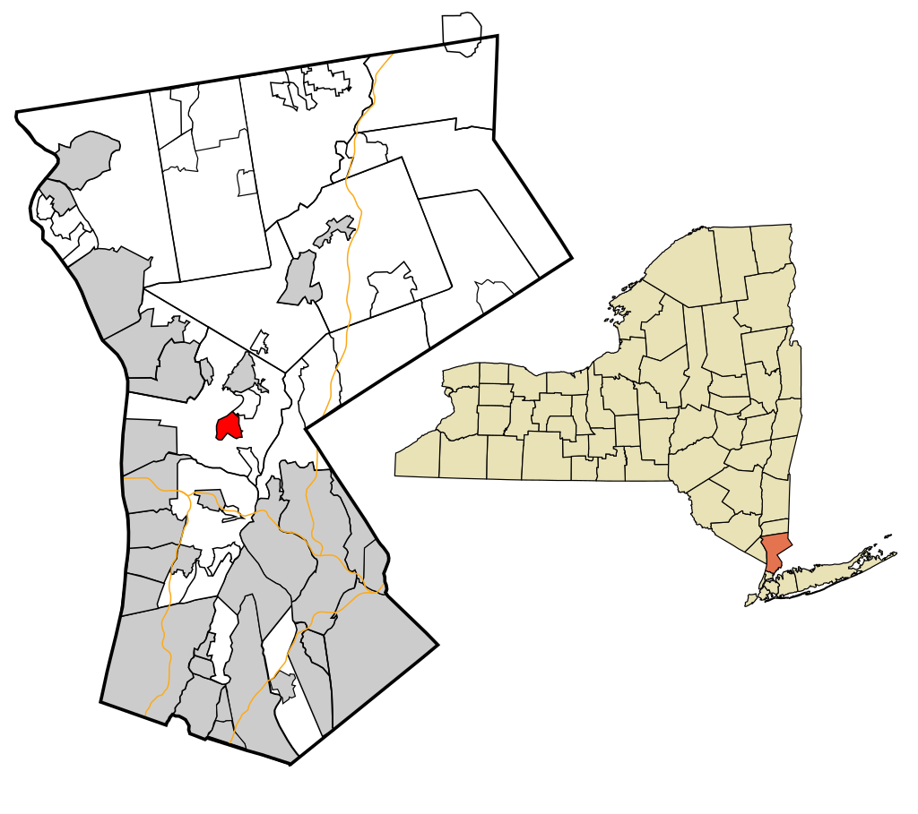
Motivation
01. Grew up in New York
02. Spent time outdoors
03. Road trips
04. Contracted Lyme disease twice
05. Explore risk in Nashville, TN
Notes:
I grew up in NY about 30 miles north of New York City.
I spent a decent amount of time outdoors, but not in the woods. Outside in the yard, local parks, etc. We were not a camping family
Did a lot of road trips as a family throughout the NE- especially PA, NJ, Conn, Massachusetts. Visit amusement parks, college visits for my older siblings
I contracted Lyme disease twice as a kid. Once when I was around 10 and then another time around 13 or so. I had the typical symptoms with recognizable rash, so my mom brought me to the doctor and I was able to get treated early and was completely fine.
Then I moved down to Nashville in 2012 and remember being told by my now mother-in-law that there really wasn’t any Lyme down here, which I easily accepted, but never really looked into. This capstone project allowed me to actually dig into the data and see if that claim was true or not, which is my overall motivation for exploring this data.

Slide 3




Questions to Explore
How has Lyme disease changed over the past several decades in the United States?
Which states are most affected by Lyme disease and has that changed over time?
Which states have experienced the most significant increase in cases?
Is there a relationship between winter temperatures and case counts?
Does adjusting for population change which states are considered most at risk?
What is the risk of Lyme disease in Tennessee and specifically, Davidson County?
Notes:
How has Lyme disease changed over the past several decades in the United States?
Which states are most affected by Lyme disease and has that changed over time?
Which states have experienced the most significant increase in cases?
Is there a relationship between winter temperatures and case counts?
Does adjusting for population change which states are considered most at risk?
What is the risk of Lyme disease in Tennessee and specifically, Davidson County?

Slide 4
Data Sources
Centers for Disease Control and Prevention (CDC)
National Centers for Environmental Information
United States Census Bureau
Case counts by month and year
Case counts by state
Case counts by county
US average monthly temperatures
Regional average temperatures
State average temperatures
US population by year
State populations by year
Tennessee County populations by year
Notes:
to answer these questions I used three main data sources:
The CDC for datasets with case counts by month and year as well as by county and state.
The National Centers for Environmental Information for data on average temperatures on a national, regional, and state level. I could filter the data and get an average temperature for specific time frames.
And finally the US Census Bureau to retrieve data on the US population, state populations, and county populations by year.
Something I’d like to note regarding the Lyme disease case counts per the CDC.
Lyme disease became a nationally notifiable condition in the US in 1991. Under the guidance of the Council of State and Territorial Epidemiologists, states and territories determine their policies on case definitions, reporting, and other factors. Reports of Lyme are collected and verified by state and local health departments based on their legal mandates and surveillance practices and then shared with the CDC via the National Notifiable Diseases Surveillance System. Surveillance data has many limitations as one can imagine with different protocols across the country. Limitations such as under-reporting, misclassification, data being captured by county of residence and not necessarily county of exposure, changing definitions, etc. The case definitions also differ depending on whether a state is considered high or low incidence.
All that to say, the analysis presented here today is using the data officially reported through routine national surveillance for Lyme disease, which is only one way diseases are tracked by public health officials. Some estimates using alternative methods suggest much higher numbers.

Slide 5
Lyme Disease
Bacterial infection spread through the bite of blacklegged (Ixodes) ticks
Typical symptoms include fever, headache, fatigue, and a characteristic skin rash
Treated with antibiotics
Untreated can lead to more severe symptoms
Diagnosed based on physical symptoms, possibility of exposure to infected ticks, ruling out other possible cause, and lab test results
Notes:
So first, what is lyme disease?
Lyme disease is a bacterial infection that is spread to people through the bite of blacklegged ticks AKA deer ticks that are carrying either bacterium: Borrelia burgdorferi or Borrelia mayonii. Symptoms can include fever, headache, fatigue, and a characteristic skin rash called erythema migrans, which occurs in about 70-80% of cases. Lyme disease is diagnosed based on signs and symptoms, possible exposure to infected ticks, consideration of other illnesses that may cause similar symptoms, and lab tests.
When caught early, Lyme can be treated successfully with antibiotics and even most patients in later stages of infection respond well to antibiotics. However, if gone untreated or untreated for too long the infection can spread to the joints, the heart, and the nervous system.

Slide 6
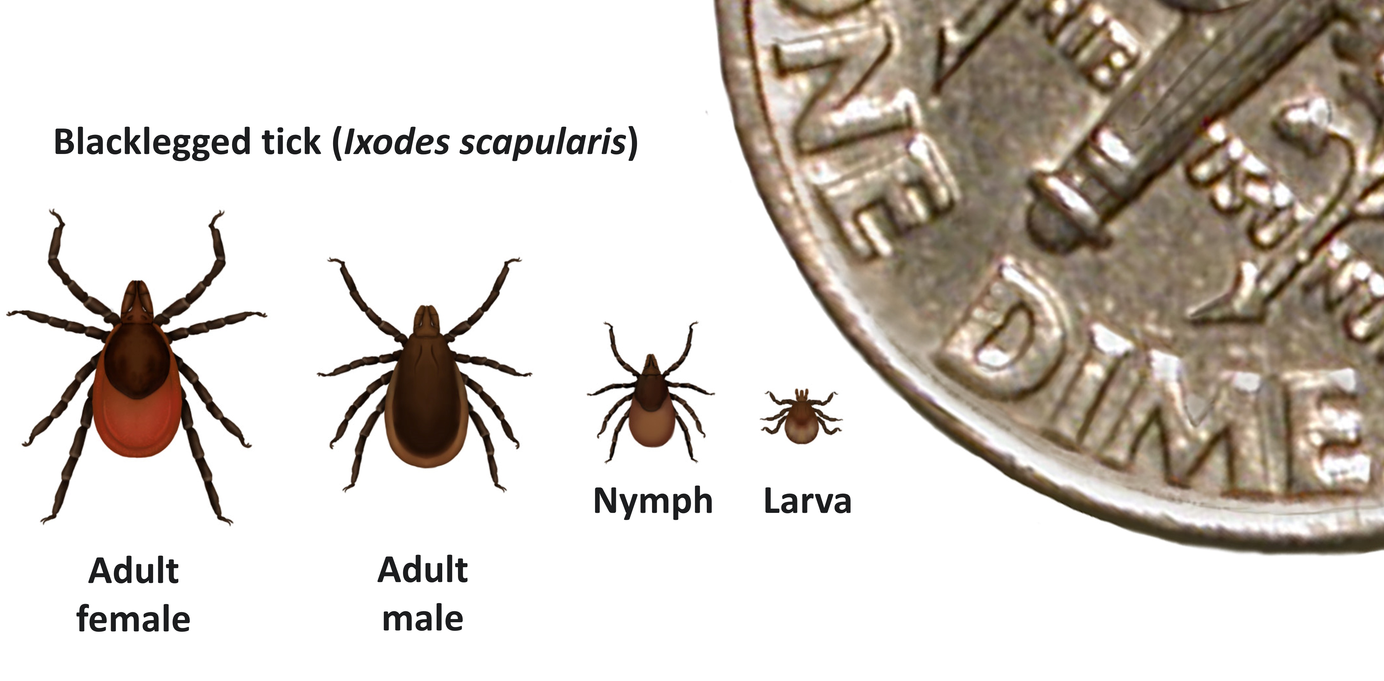
Blacklegged Ticks
Found most commonly in forested areas
2 to 3 year lifespan
4 life stages
Notes:
A little background on deer ticks:
These ticks are found most commonly in forested areas that provide moisture and shelter in northeastern, north-central, and mid-Atlantic states, as well as in smaller areas within Pacific Coast states. They are most active during the warmer months and go dormant when it is below freezing. The blacklegged ticks have a 2 to 3 year life span during which they go through 4 different life states- from egg to larva, to nymph and finally, adult. As you can see from the picture- ticks are quite small. Adult ticks are about the size of a sesame seed and ticks in the nymph stage are the size of a poppy seed.

Slide 7
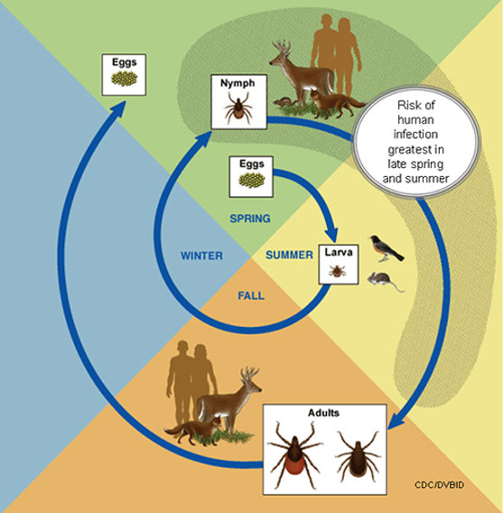
Tick Life Cycle
Require a blood meal
Smaller animals infect the ticks
Attach for at least 24 hours
Notes:
For a tick to transition from larva to nymph and from nymph to adult- they must take a blood meal from a wildlife host such as a rodent or deer. Adult females also require a blood meal in order to produce eggs, It’s during these blood meals the ticks can become infected with the Lyme disease bacteria. Smaller animals like white-footed mice, shrews, chipmunks, etc. are the typical reservoirs for the bacteria. They then can pass it on to their next host when feeding again. The typical course is the larva contracts the bacteria during it’s first feed to transition to the nymph stage. Then the nymphs are often responsible for transmission to humans because they are so small and hard to detect whereas infected adults are larger and more likely to be noticed and removed. This is important because ticks must be attached for at least 24 hours for the bacteria to be transmitted.
however the bacteria is not transmitted to the offspring.

Slide 8
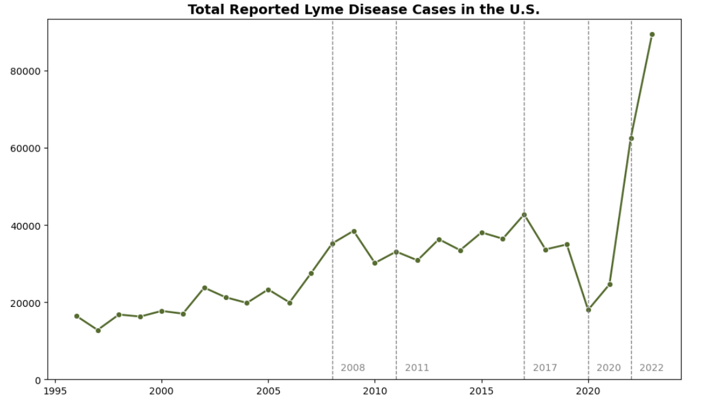
US Case Counts (1996-2023)
Notes:
Now that we know a little bit more about the blacklegged ticks and how they transmit Lyme disease, we’re going to start looking at our case trends across the country.
Here we see the total number of cases across the US from 1996 to 2023, which has been steadily rising across that time frame. The dashed line in 2020 represents COVID- around this time period we see a dip in reported cases, which can be explained by underreporting due to strained resources on the health provider side as well as changes in the healthcare seeking behavior on the patient side.
The other vertical dashed lines are years that the national surveillance case definitions for Lyme disease were modified. We see in 2022 there appears to be a significant rise in cases. This could be due to the reporting behaviors normalizing after a couple of years of COVID as well as a rule change that made it easier for some states to report Lyme.

Slide 9
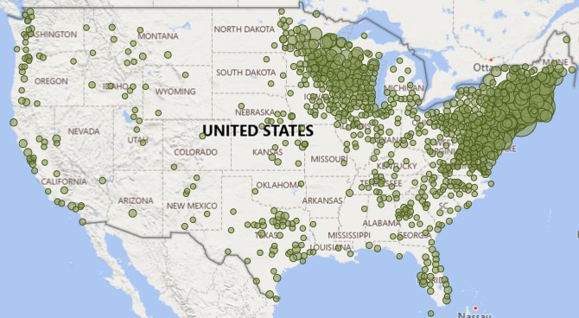
2008
Notes:
We’re going to drill in and look at cases between 2008 and 2023, so a 15 year period where we have the most complete data on a county and state level.
I wanted to visualize how these cases are dispersed by county across the US in 2008. Although we see reported cases all across the country, we clearly see high concentrations in the northeast as well as Wisconsin and Minnesota.

Slide 10
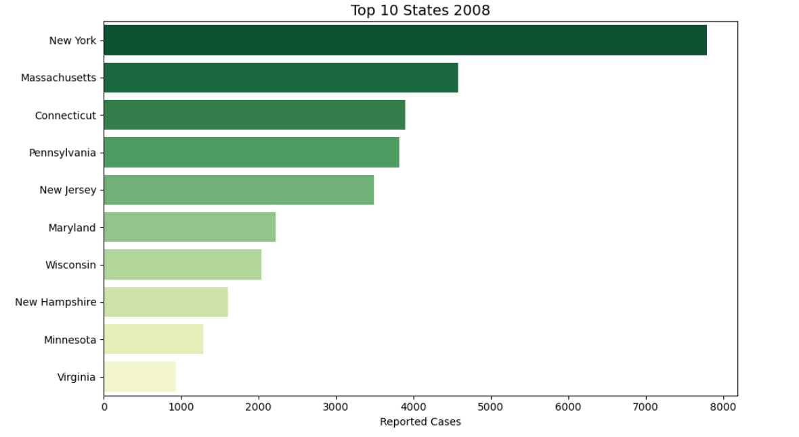
States with the Highest Counts in 2008
Notes:
As expected based on where blacklegged ticks are most found- states in the northeast and north-central regions had the highest counts of Lyme disease in 2008

Slide 11
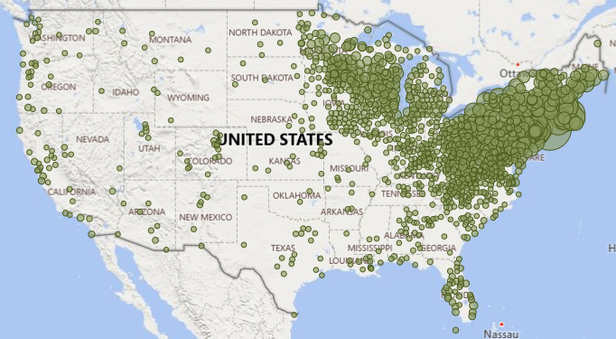
2023
Notes:
Moving forward to 2023- we still see those high concentrations in the northeast and north-central regions with even more cases, but now we’re also seeing an increase in cases in states like Ohio, West Virginia, Indiana, Michigan, and Kentucky. Looks like cases are creeping in a southwest direction as well as north.

Slide 12
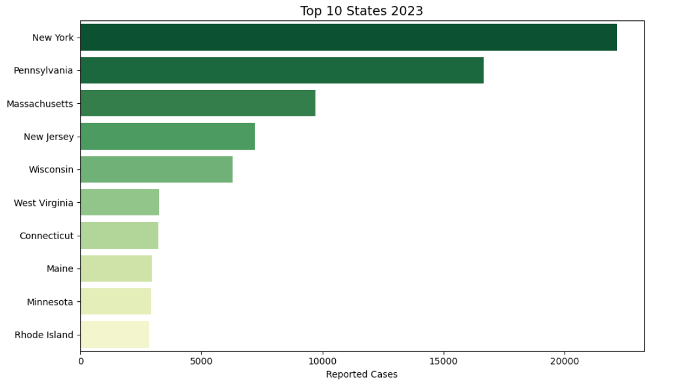
States with the Highest Counts in 2023
Notes:
Once again, when we look at case counts we’re seeing the same states and regions as in 2008. This makes sense since this is where these ticks have historically lived and have a foothold already, but now all of these states have seen increases in reported cases of Lyme.

Slide 13
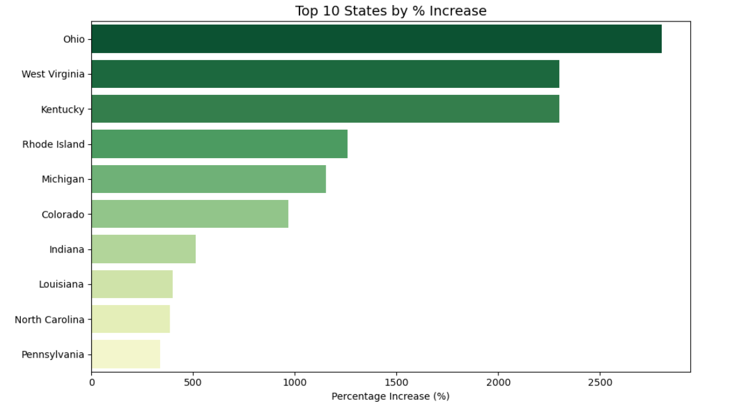
States with the Highest % Increase
Notes:
I wasn’t surprised by those states with established lyme disease seeing a rise in their case counts. What I wanted to see next was which states saw the greatest increase in cases from 2008 to 2023. Here we see Ohio saw a significant increase in reported cases in that time frame with 45 in 2008 and up to 1307 in 2023. West Virginia a similar change- 135 cases in 2008 to 3242 in 2023.
Now, in total case counts, these pale in comparison to states like New York that had over 22k cases in 2023, but still- some of these states have seen substantial increases in reported Lyme disease

Slide 14
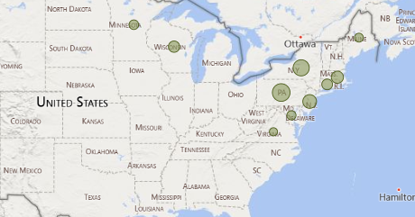
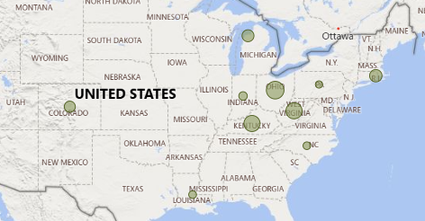
Top 10 States by
Total Cases
Top 10 States by
% Change
Notes:
To the left we see the top 10 states by total case count for the 15 year period, but when we shift our focus to states with greatest percentage change in case count we start to see a different picture. We start moving out from the northeast and moving towards the Midwest.
This made me curious and I wanted to look into some factors that could be possibly affecting the rise in case counts in general, but also more specifically in some of these states experiencing such dramatic growth. And that’s when I decided to focus on how temperature may be impacting Lyme disease.

Slide 15
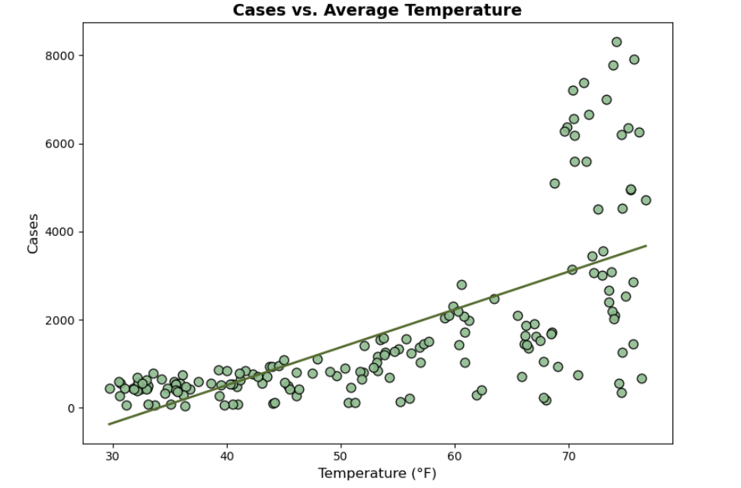
US Cases vs Average Temperature
Notes:
When we look at total cases of Lyme in the US as a whole compared to the average temperature of when those cases are being reported, we see very clearly a positive relationship. Around the freezing point, there are hardly any cases reported at all, but as the weather warms up, cases of Lyme go up, especially around that 70 degree mark. So this would indicate that ticks are more active during the warmer temperatures. This graph shows cases of Lyme being reported by humans obviously, but this would also mean ticks are finding other hosts during this time as well, potentially contracting the Lyme disease bacteria.
Comparing cases reported each month vs average temperature of that month

Slide 16
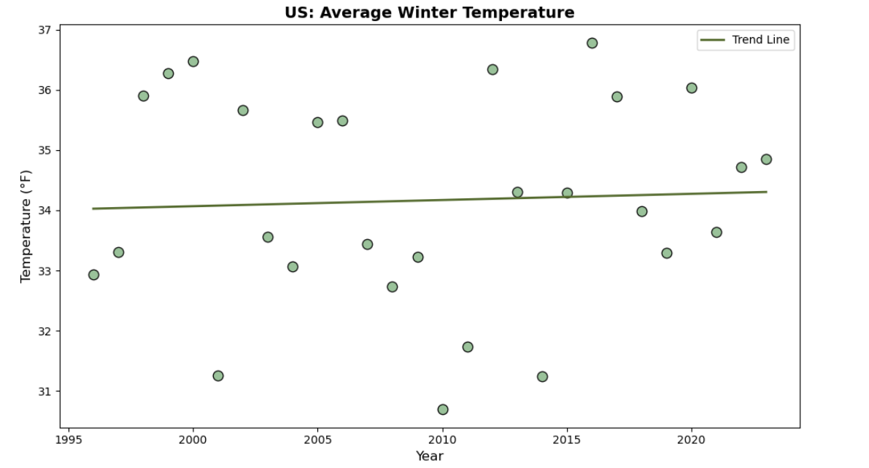
US Average Winter Temperature
Notes:
We know that temperatures are rising globally and from the last graph, we learned a majority of cases are reported when temperatures are higher. Although temperatures are rising, it’s incremental, so I wasn’t very interested in looking at exploring temperatures during the warmer months. I figured tick behavior and Lyme cases wouldn’t differ too much. I was interested in what kind of impact winter temperatures have on total cases reported for that year. As winters get warmer and temperatures stay over freezing, ticks are less dormant and therefore, actively looking for hosts- potentially contracting and spreading Lyme.
I designated December, January, and February as Winter and found the average temperature across those three months for the US. Here we do see a slight increase in average winter temperatures over time.

Slide 17
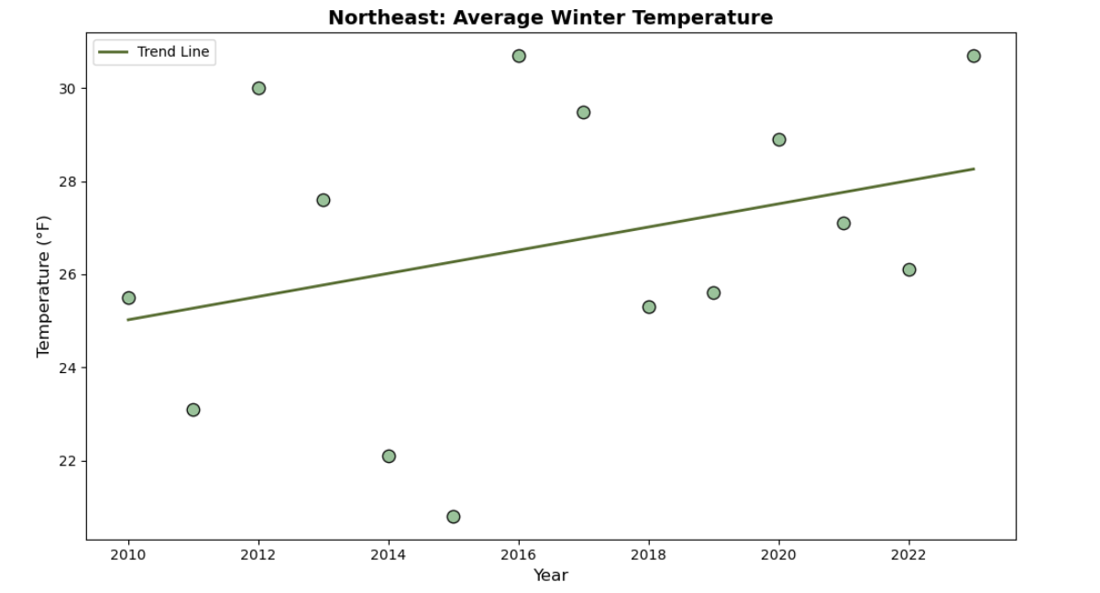
Northeast Average Winter Temperature
Notes:
I first wanted to focus on the Northeast- the region we know has the most Lyme disease. This graph shows that the average winter temperature is rising in the region. However, let’s note that the average temperature is still below freezing.

Slide 18
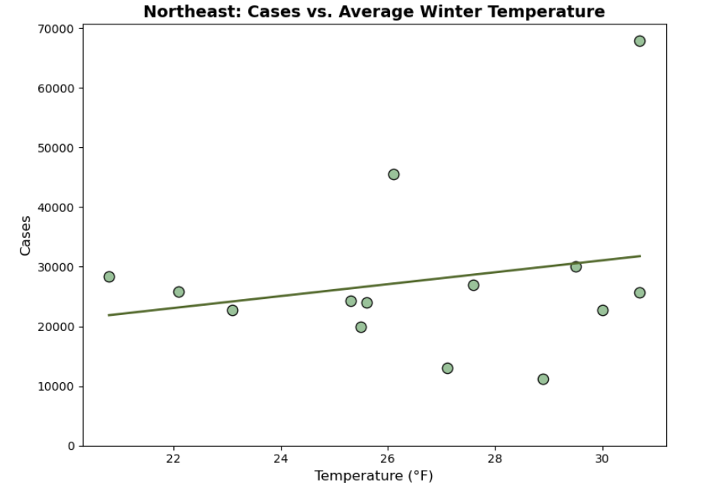
Northeast Cases vs. Average Winter Temperature
Notes:
When we look at total cases versus average winter temperature- we see a slight positive relationship, but nothing too strong and I think this is because the average temperature in the winter has remained below freezing. Meaning the ticks are not active- not feeding on hosts- human nor animal, so in the Northeast the tick active season has pretty much remained constant.
I will note this data point in the top right corner is from 2023, which we saw earlier that there was sharp rise across the board in case counts- most likely due to the change in case definition. We will see a point like this on all of the graphs.

Slide 19
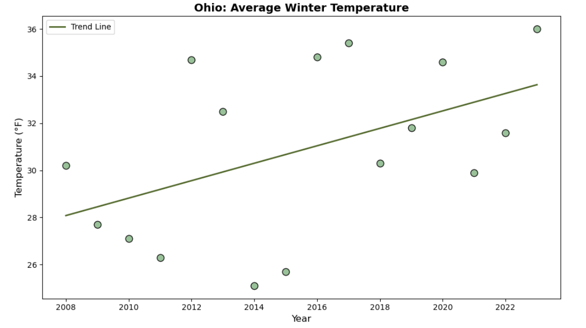
Ohio Average Winter Temperature
Notes:
I then wanted to look at a couple of those states that had the highest percentage growth in cases- first we’ll look at Ohio.
Here is a graph showing the change in average winter temperature in Ohio over the past 15 years and we can clearly see temps have been rising. What I want to point out here is that earlier in this time frame Ohio’s average winter temperatures are below freezing. As time goes on, it’s hovering around freezing or above.

Slide 20
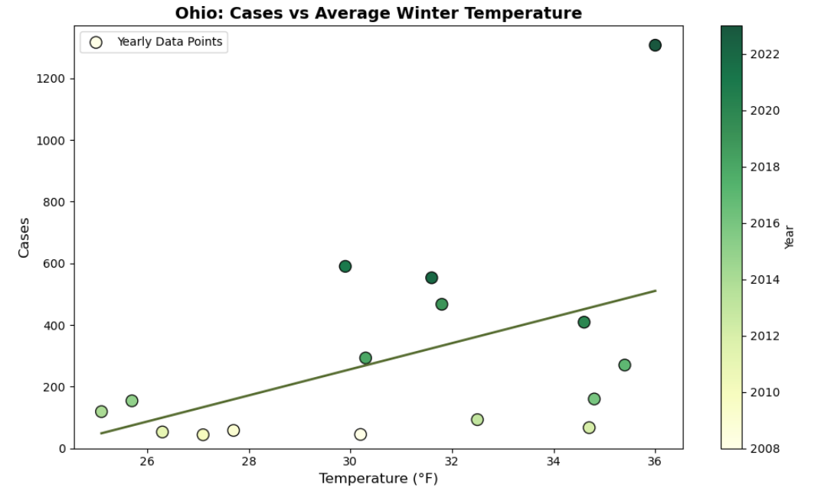
Ohio Cases vs. Average Winter Temperature
Notes:
Now we’re looking at the relationship between average winter temperatures and case counts and we see a stronger relationship here than in the Northeast. Data points are colored based on year, so we can have another look at change over time. From this data, it appears like winter temperatures have been increasing over time as well as total number of reported cases.

Slide 21
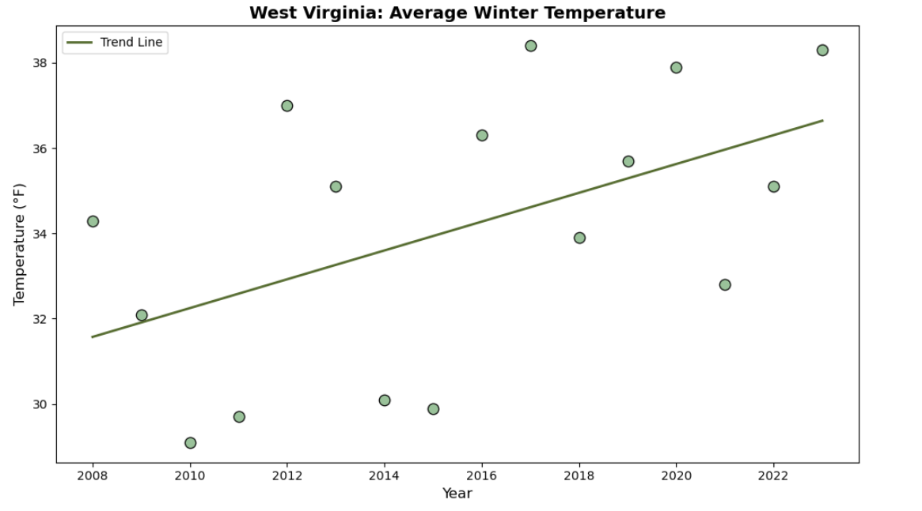
West Virginia Average Winter Temperature
Notes:
Now we’re looking at West Virginia- the state with the 2nd highest increase in number of cases over the past 15 years. Here we are seeing a rise in average winter temperatures. West Virginia appears to have warmer winters than Ohio, but still has had winters averaging around freezing and below.

Slide 22
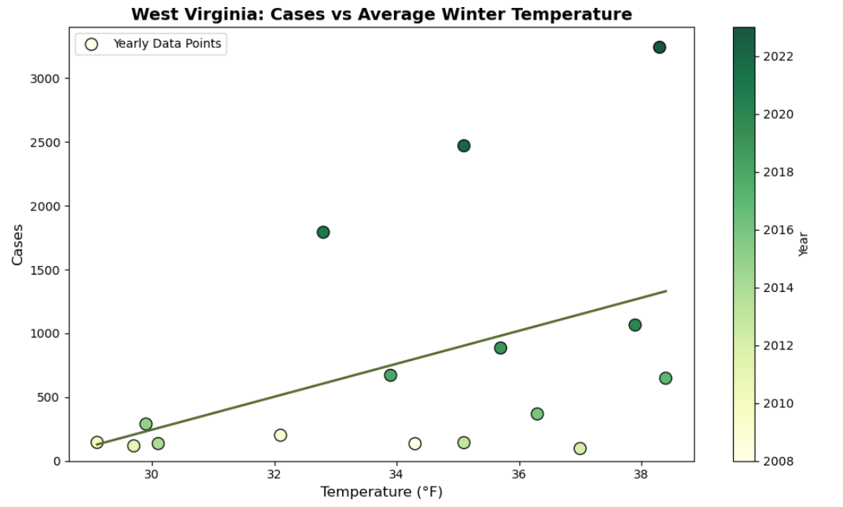
West Virginia Cases vs. Average Winter Temperature
Notes:
Once again, we’re seeing a positive relationship between average winter temperatures and total cases for the year here in West Virginia.
Ticks become active any time temperatures go above freezing. As the winters get warmer the ticks have a longer active season, more time questing for hosts- more time to potentially spread Lyme. Areas that were once not as hospitable to the blacklegged ticks due to colder winters may begin to see far more cases in the future. Especially in these border states outside of the high concentration regions that currently have relatively low case counts and I think we’re starting to see that here.
Now, up to this point, we’ve been looking at trends based on just case counts. The number of cases has been growing and spreading to new areas and honestly, doesn’t look too promising. However, the US is a big place with a lot of people in it, so we need to take a step back and look at Lyme disease taking population size into account.

Slide 23
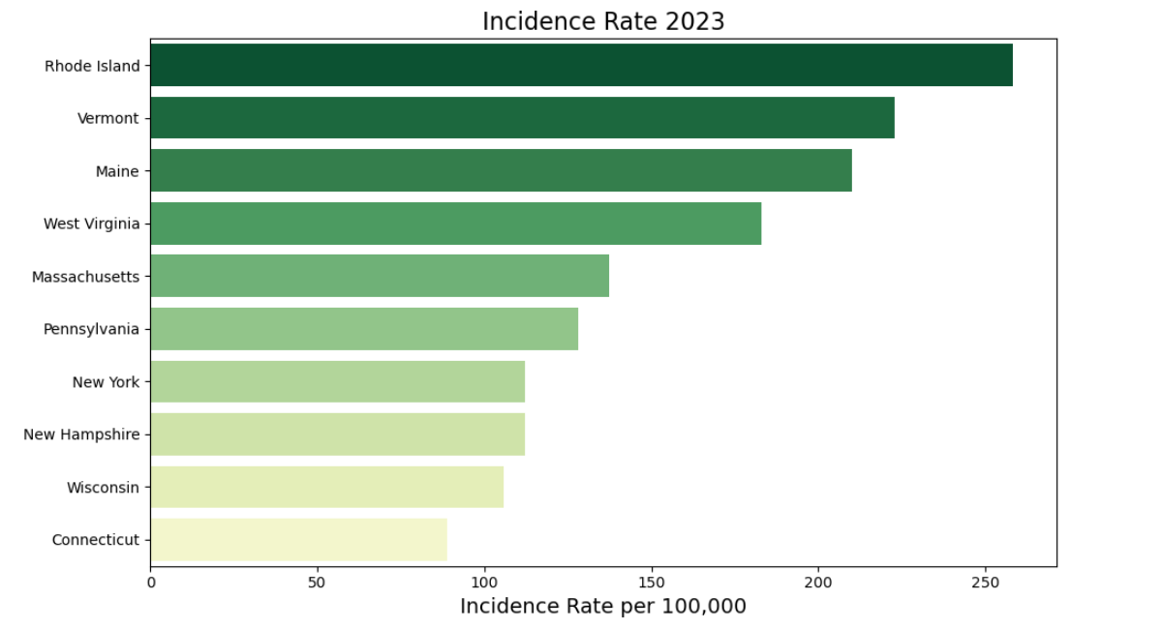
Incidence Rates 2023
Notes:
When you factor in population size to calculate the Incidence Rate- we see that it’s not New York, the state with the highest case count in 2023, that is most at risk. It’s Rhode Island with about 258 cases per 100,000 people. New York’s Incidence rate is about 112 a lot lower than Rhode Island even though it had far higher case count. Taking a look at the other states in the top 10, it appears that the New England region is really most at risk for contracting Lyme if bitten by a tick.

Slide 24
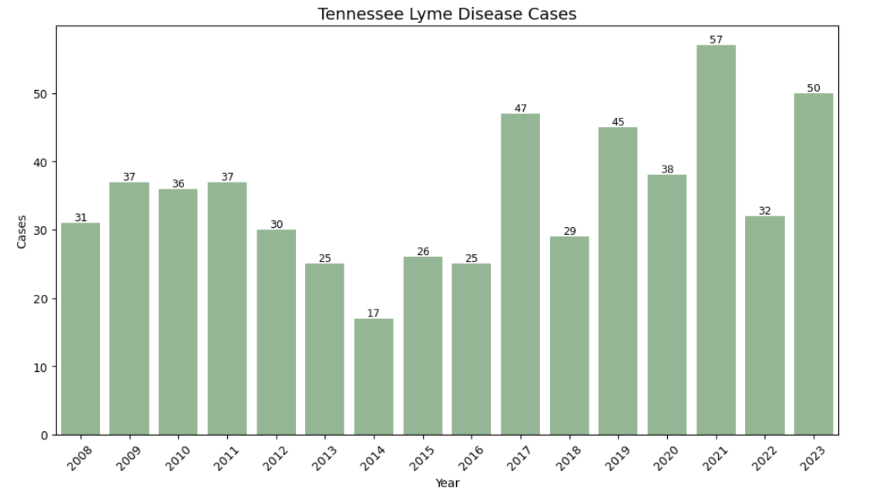
Tennessee Case Counts
Notes:
Finally, I want to narrow our focus to Tennessee and evaluate our risk for Lyme here in Davidson County where I live. Here we see cases across the state have been fairly low since 2008. In 2023, there were only a total of 50 cases across the entire state.

Slide 25
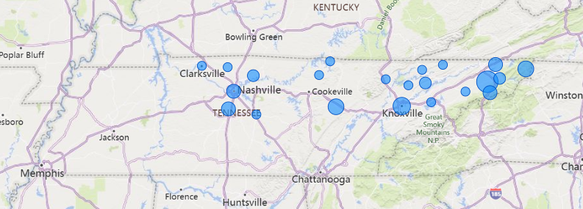
Tennessee Cases 2023
Notes:
Those 50 cases were distributed across the state, but mostly in Middle and East TN- towards the northern part of the state.

Slide 26
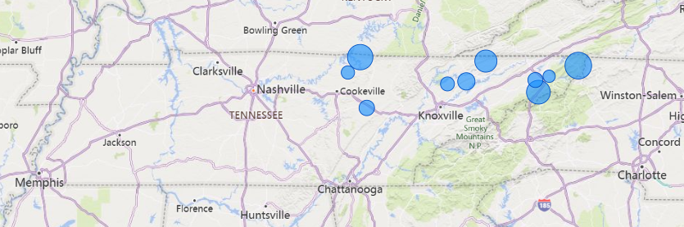
Tennessee County Incidence Rates 2023
Notes:
When we factor in population size, all of the counties with the highest incidence rates are concentrated in the northeastern portion of the state. Johnson County has the highest rate of about 22 cases per 100,000. However, it’s important to note that they only had 4 cases reported in 2023. And we notice that Davidson county has fallen off the map.
So finally, let’s look at Davidson and what sort of risk we run here.

Slide 27
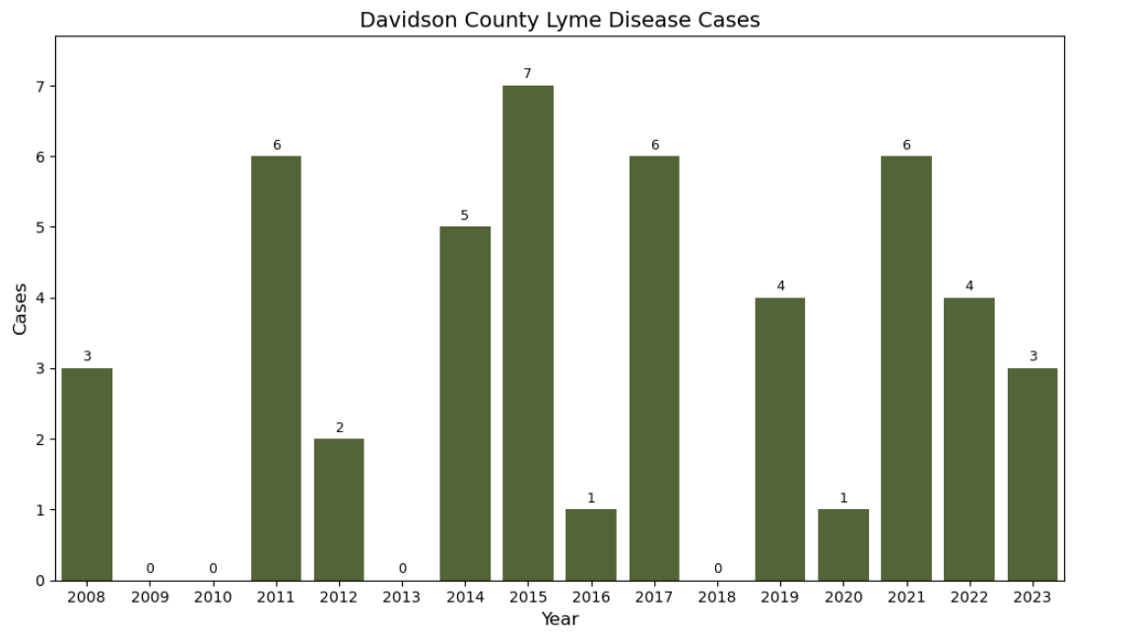
Davidson County Case Counts
Notes:
For a county with over 700,000 residents, there have been very few reported cases of Lyme. Only 3 cases in 2023- that calculates to .42 cases per 100k per year. That is very low- almost non existent. And looking at the maps from before- makes me think that those 3 cases could be people who live in Nashville, but who travelled elsewhere like maybe eastern TN for a vacation since cases are reported based on the county you reside.
This has been a huge relief! I feel fairly confident that I’m not going to contract Lyme disease here in town

Slide 28
Opportunities for Further Analysis
Climate factors
Deer tick distribution
Behaviors and migration of host animals
Reporting
Deforestation
Urban development
Human behavior
Notes:
I have learned that Lyme disease is way more complicated than I imagined. There are many variables when it comes to exploring Lyme disease and its effect on humans. Climate change is just one piece of the puzzle- it effects not only the ticks themselves, but also the host animals they feed off of. Humans behavior, Urban development and deforestation, Differing reporting standards. The list goes on. The most important thing out of all of this though is if you believe you may have Lyme disease then go seek medical attention as soon as possible.

Slide 29
Check for ticks!
Be aware of where ticks live
Wear long sleeves and long pants
Wear insect repellent
Check yourself after being outside
Notes:
I just want to thank you so much for your attention and listening to my findings and please make sure that you check yourself for ticks!

